Slide 1
CS 341 Lab 7
Fall 2020

Slide 2
Lab 7
Goal: control a 7-segment display
We will use an integrated circuit to make our code simpler

Slide 3
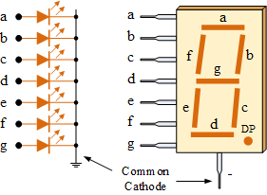
7 Segment Display
Displays numbers by on and turning off 7 LEDs
We need 7 digital inputs to control it
Example: What pins should we turn on to display 7?
Answer: a, b, c

Slide 4
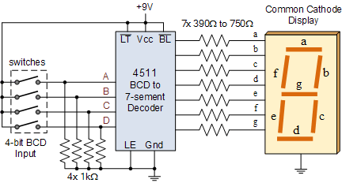
Decoder
We can reduce the number of digital inputs to 4 by using a decoder
It takes in a four-bit input and outputs the correct 7-bit signal
Example: 7
7 in binary is 0111₂
Input 0111 to decoder
Output 1110000
We see 7 on display
Decoder
4 Digital Pins

Slide 5
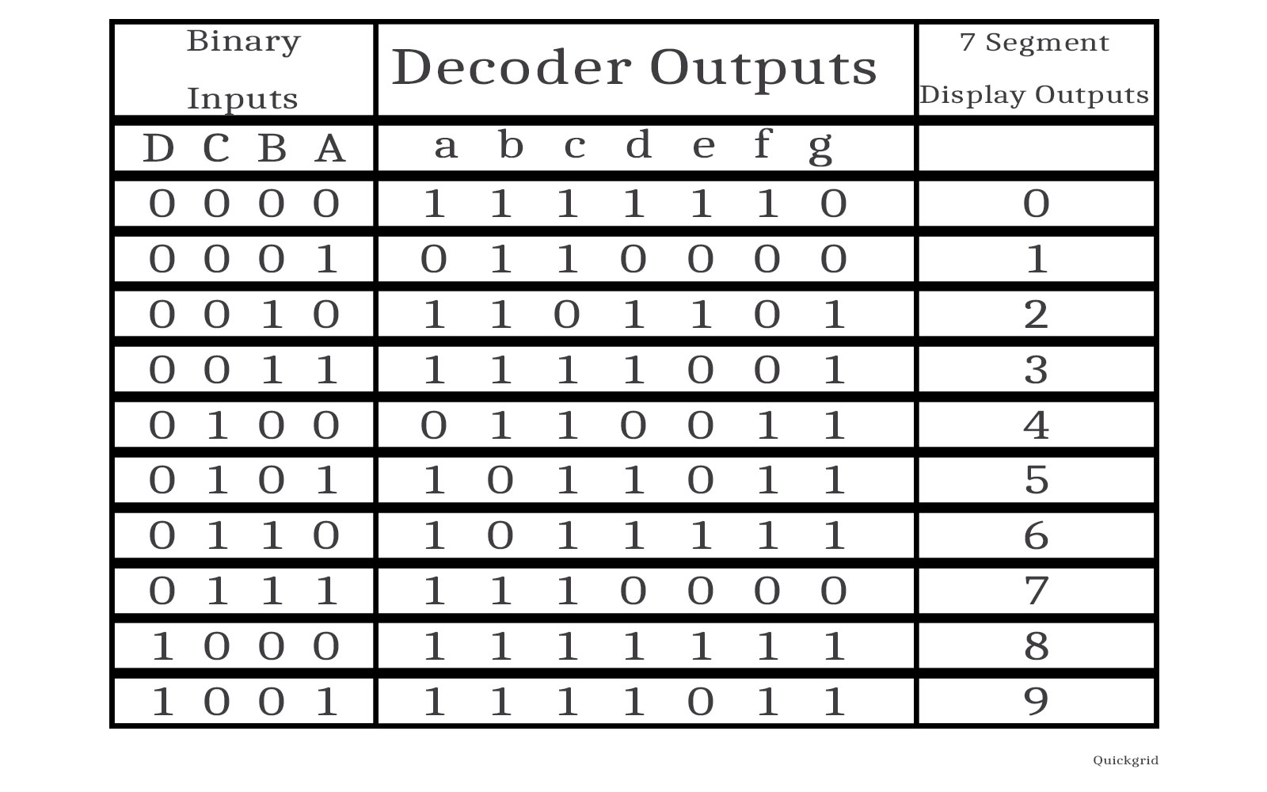
Decoder

Slide 6
Lab 7
Complete the circuit as provided
Create a counter that starts at 0, and counts up to 9, it should then loop back to 0
Note: make sure the 7 segment display is set to cathode, not anode

